Slide 1


Jest - Advanced Features

Slide 2
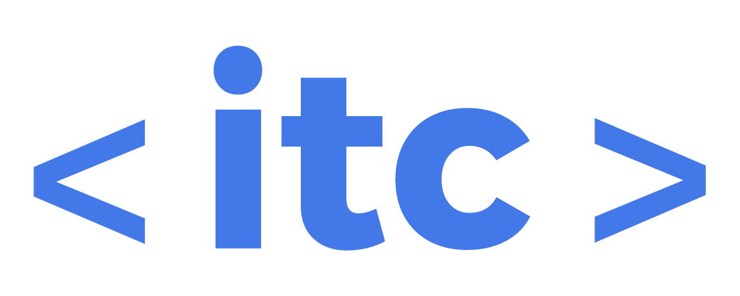
Agenda
Test.each
Coverage
Handling unexpected results - Throwing errors
Async code: Callbacks, async/await, promises.
BeforeEach // beforeAll
AfterEach // afterAll
Skipping timers
Mocking functions and modules
Mocking fetch()

Slide 3
Disclaimer
This slides contain more advanced content than the first ones.
To properly understand the content, please be sure that you are comfortable on handling promises, using async and await, understand what does reject and resolve do.
Please be sure that you are familiar with throwing errors and using try/catch.
Also worth to mention, remember that fetch returns a Promise.
Please, take 10 minutes to refresh the contents that you might need.
This is not break time.
We will be back at:

Slide 4
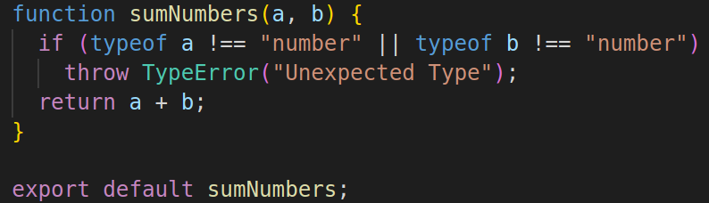
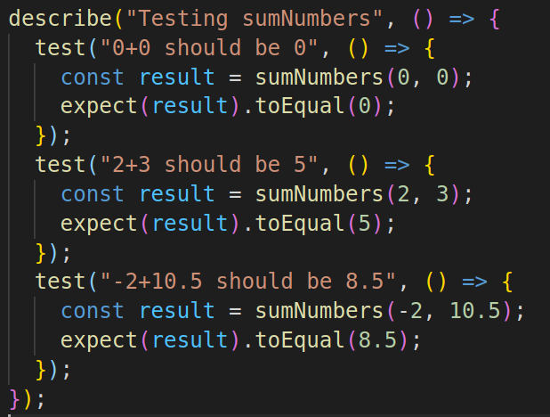
Test.each
To avoid code repetition, Jest includes a test.each method:
With test.each we can run a set of cases and run repetitively the test changing the parameters, delivering smaller amount of code.

Slide 5

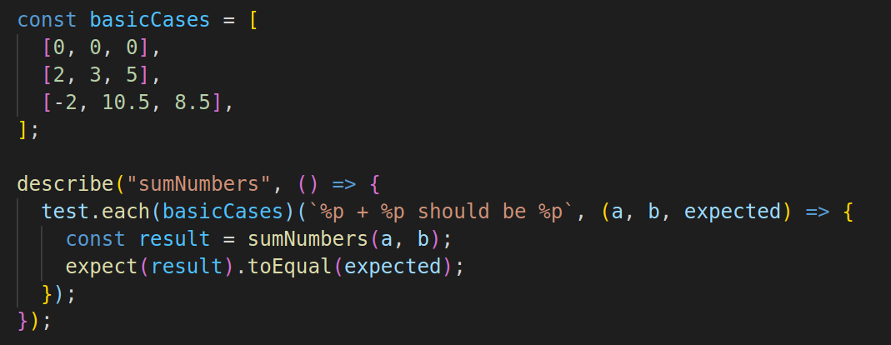
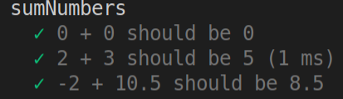
Test.each
To avoid code repetition, Jest includes a test.each method:
On top : the const basicCases holds all the parameters (indexes 0 and 1) and also the expected result. Each of this elements is taken by the arrow function on the same order.

Slide 6
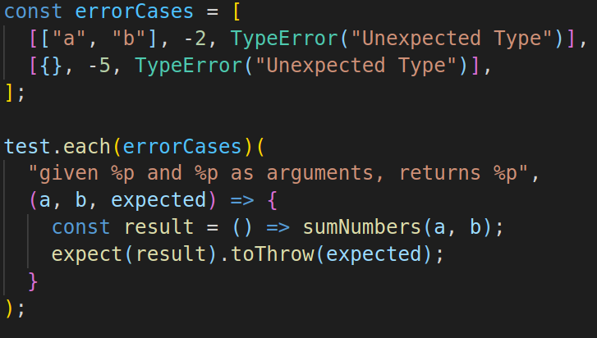
Test.each
We can do the same for testing the errors:
The same can be done with the cases where the tests supposed to raise an error

Slide 7
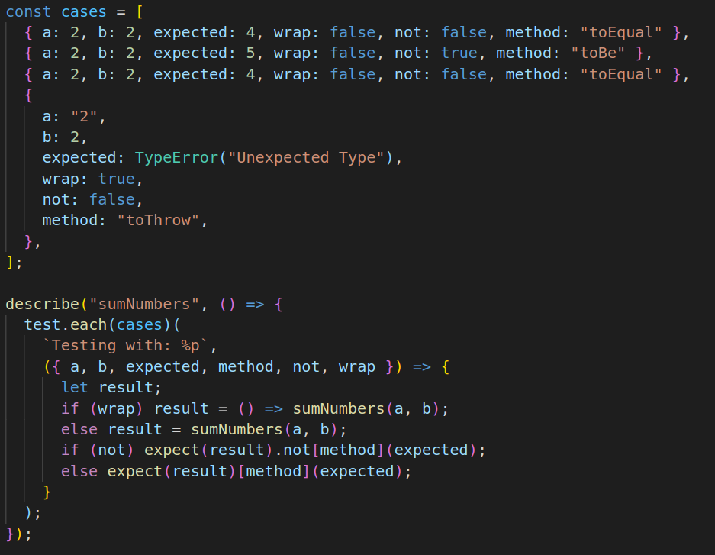
Test.each
We can even be more generic:
Be careful not to be more pragmatic than what your needs are.
Be sure not to build a structure that is more complex than what it needs to test.
Despite being able to create a model like the one on the right, is it justified for a sumNumbers function? The test.each turns a little bit harder to read in order to take two different syntaxes (testing for both errors thrown as well as .toEqual)
The fact that we can do it, doesn't mean that we have to in all the cases.

Slide 8
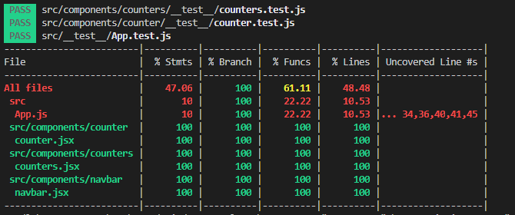
Coverage
Jest includes a CLI method that can report how much of your code is covered by tests.
It is not a 100% accurate tool, and can be easily tricked (you can be testing all the lines, but not in a proper way) but helps to have an overview of the amount of coverage of the tests.
jest --coverage

Slide 9
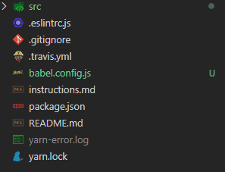
Coverage
Sometimes, it throws errors on the compiler.
Most of the cases would be to babel not being set with the right presets.
To fix it, create a babel.config.js file at the root project:
module.exports = function (api) {
const presets = ['@babel/preset-env', '@babel/preset-react'];
plugins = [['@babel/plugin-proposal-class-properties']];
/** this is just for minimal working purposes,
* for testing larger applications it is
* advisable to cache the transpiled modules in
* node_modules/.bin/.cache/@babel/register* */
api.cache(false);
return {
presets,
plugins,
};
};

Slide 10
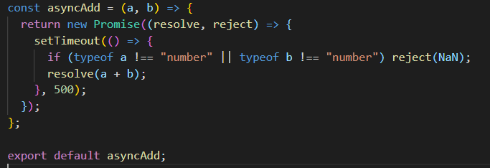
Testing an async Function
asyncAdd: the function returns a Promise that will resolve afterwards half a second. If the params are numbers, it will add them, if not, it will reject it with NaN
Since we are returning a value that comes from within a setTimeout, we need to wrap it into a Promise.
NaN documentation

Slide 11

Testing an async Function
When testing an Async function there is an assert that must be always added:
expect.hasAssertions()
or
expect.assertions(<number_of_assertions_expected>)
The reason is, sometimes you might not be properly awaiting for the assertion, and if so, the test will falsy pass. By adding that expect, the test won’t pass if it didn’t assert.

Slide 12
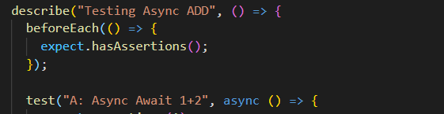
Testing an async Function
An easy trick to always make sure that the assertions are always checked:
beforeEach and afterEach are methods that will run in each test.
They are useful for the cases that we want to perform the same operation in all of them (like in this case) or to perform cleanup operations (for example, when testing a db you might want to close the DB connection after each test)
In this case, we can use beforeEach with expect.hasAssertions() to make sure that at least one assertion was run in the test.

Slide 13
Testing an async Function
When testing an async function, there are several syntaxes that can be used.
We can use async/await
We can use the promise syntax with .then and .catch and make sure we return the promise (otherwise it will be skipped) or we call to the done() method.
We can use expect.rejects or expect.resolves to unwrap the value of a fulfilled promise so any other matcher can be chained.
No matter the syntax / flow chosen, make sure you are always awaiting for the result before comparing it to the matcher and that you have included a way to check that there are assertions in the test...
Let’s give a look to some test cases for asyncAdd

Slide 14
Testing an async Function
In the following slides you have some snippets that test our asyncAdd function.
They all achieve the same.
Jest with different syntax.
😁

Slide 15

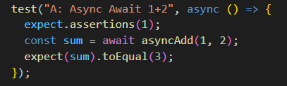

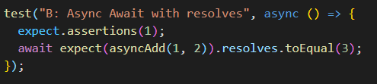
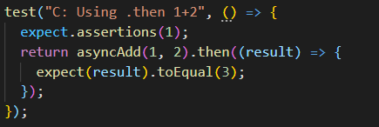
Testing an async Function
Case A: No need to return or await the expect since by the time is called sum has already resolved.
Cases B and D: We need to await/return for the expect. Otherwise the test function will run without waiting for asyncAdd to solve
Case C: Same as D, in order to wait for asyncAdd to solve, we need to return it or await it.

Slide 16
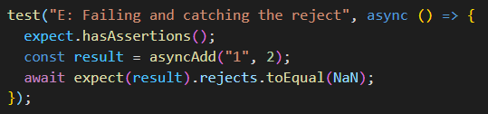
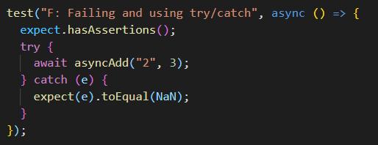

Testing an async Function
Now let’s give a look to some tests that expect the asyncAdd to reject with NaN:

Slide 17
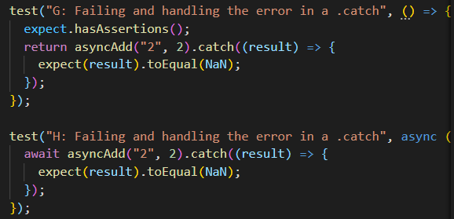
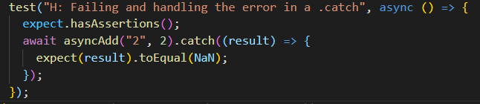
Testing an async Function

Slide 18
afterAll & beforeAll
When running a test suite, Jest provides and afterAll and beforeAll functions that run after / before the tests are completed.
They are useful for:
Cleanup
Setting configurations before running the test
That function may return a generator or a promise, and it will wait for your promise or generator function to finish its execution before it continues.

Slide 19
afterAll & beforeAll
// MyTestFile.test.js
afterAll(() =>; {
cleanResources();
});
beforeAll(() =>; {
runDbConnection();
});
describe("MyComponent",() =&gt; {
test("should do this..",() =&gt; {
expect(prop).toBeTruthy();
});
});

Slide 20
afterEach & beforeEach
Unlike afterAll and beforeAll, these functions are called for each test case in your test file.
By using beforeEach, you can create a connection to your database before each test case start to run, for example.
As a best practice, you should use afterAll to remove your created DOM elements after each test case run.

Slide 21
afterEach & beforeEach
afterAll(() =>; {
resetDomTree();
});
beforeAll(() =>; {
createDomElement();
});
describe("MyComponent",() =>; {
test("should do this..",() =>; {
expect(prop).toBeTruthy();
});
test("should do that..",() =>; {
expect(prop).toBeTruthy();
});
});

Slide 22
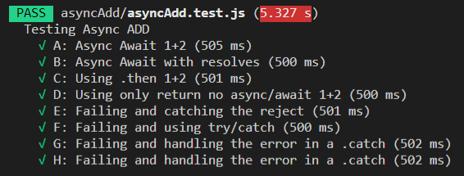
Using Fake Timers
Jest has a built in methods to skip the timers. The most popular is runAllTimers. Since our setTimeOut was set at 500ms, we will need to wait them to finish in order to run our tests.
Now, this can be skipped by using:
jest.useFakeTimers() // Allows to mock the times
jest.runAllTimers() // will skip the timers
jest.useRealTimers() // closes the mocking, cancels useFakeTimers()
Left: Each test is taking at least 500 ms, the time set on the setTimeOut

Slide 23
Using Fake Timers
Jest has a built in methods to skip the timers. Since our setTimeOut was set at 500ms, we will need to wait them to finish in order to run our tests.
Now, this can be skipped by using:
jest.useFakeTimers() // Allows to mock the times
jest.runAllTimers() // will skip all of them
jest.useRealTimers() // closes the mocking, cancels useFakeTimers()
Let’s give a look on how to write a test skipping the timers.

Slide 24
Using Fake Timers
Recipe to use a fake timer:
Inside your test function, launch jest.useFakeTimers()
Trigger the call on a non blocking way (don’t use await for blocking the code until the result is solved)
Afterwards the call to the async function has been done, and JS is waiting for it to be resolved, you can skip the timers. Place your jest.runAllTimers() afterwards that call.
Do your assertions
Cleanup: Before exiting the test, make sure you cleaned the timers, by running jest.useRealTimers().
The combination jest.useFakeTimers() and jest.useRealTimers() can be placed in a beforeEach and afterEach block.

Slide 25
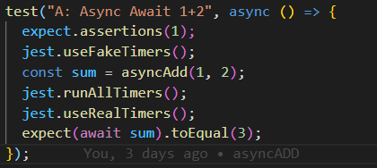
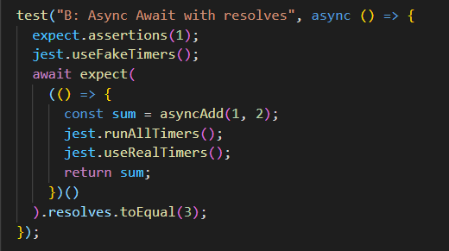
Using Fake Timers

Slide 26
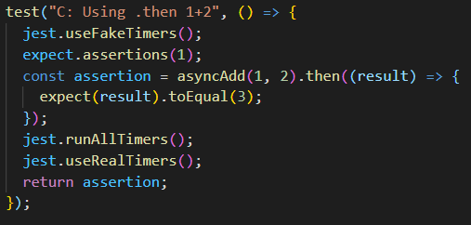
Using Fake Timers

Slide 27
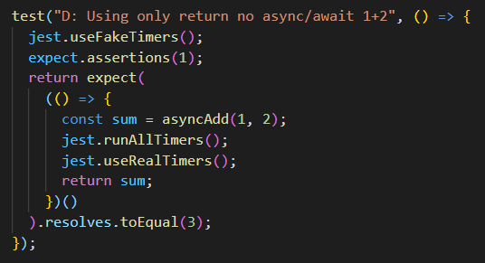
Using Fake Timers

Slide 28
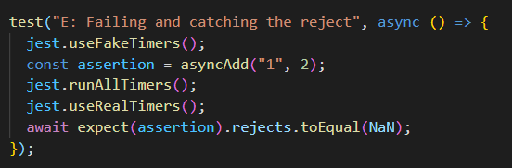
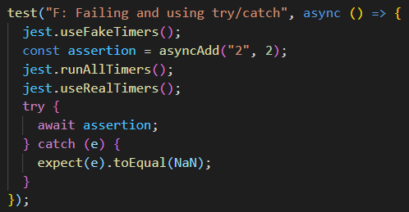
Using Fake Timers

Slide 29
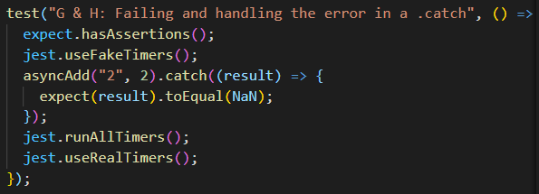
Using Fake Timers

Slide 30
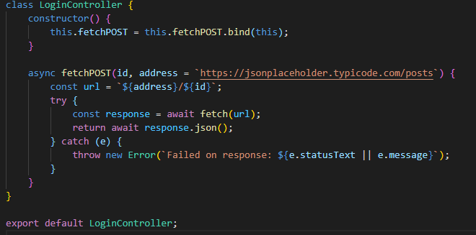
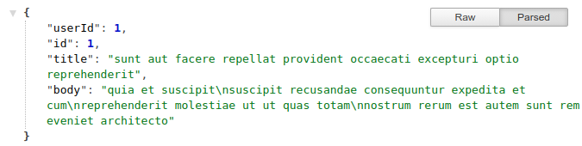
Testing fetch
Let’s say we have a function that is fetching a post note, and should return whether the note or an error.
We don’t have access to the address where we are making the request.
How do we test it? We can’t control the response from the server (or we shouldn’t depend on it at least) Or maybe we don’t want to test the server itself, but only our function.
Also, we don’t want to make lots of calls to an endpoint that might have costs implied.
Lastly, NodeJS doesn’t know what fetch is… Since it is a browser method.
Response provided on fetching /posts/1
Notes:
If (!response.ok){}throw new Error('Server error' )

Slide 31
Mocks
These are typical candidates for mocks:
Browser methods
API calls (Fetch)
Conditions difficult to generate in a test environment
What can you mock?
Functions
A whole module (for example, the whole Axios module)

Slide 32
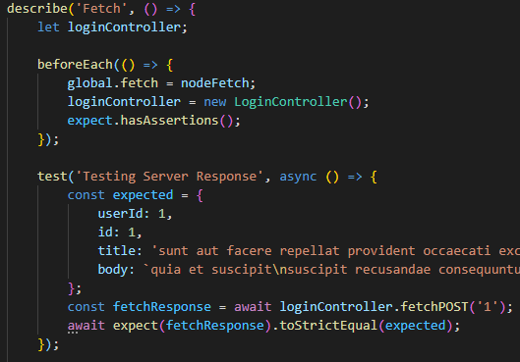
Testing fetch by actually fetching
A first Approach
We can add as a dependency any other fetch library (node-fetch, isomorphic-fetch, etc) and import it as a global to NodeJS.
We would be able to make a REAL calls to the server.
But….
It might cost time & money
We are depending on the API not to have changed their structure
We are depending on the API not to be down
And on an on….

Slide 33
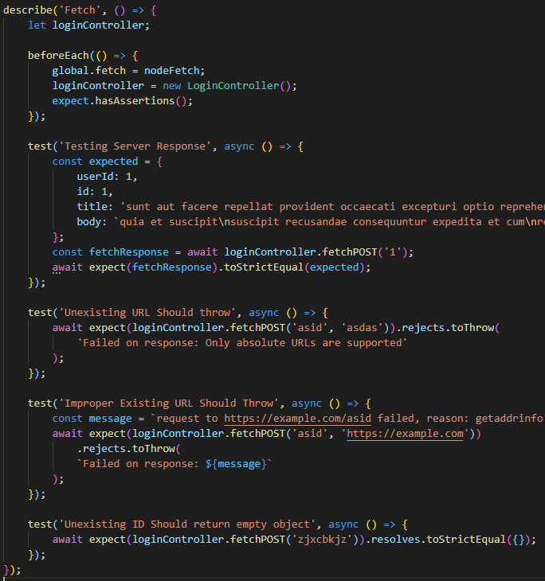
Testing fetch by actually fetching
Handling Errors
We can still handle errors the same way we did with Jest on the previous lectures.
Since we are dealing with promises, if we are not properly awaiting for it, don’t forget to unwrap it using .rejects or .resolves.
In our case, fetching an existing ID resolves properly with an empty object.

Slide 34
Mocking fetch
Another approach:
We will replace the actual fetch for another one mocked up, that won’t make any call to any api, but it will reject / resolve according to our needs. We will manually specify what that mock will retrieve.
For that, we will need to install a package called jest-fetch-mock
yarn add -D jest-fetch-mock
Documentation:
http://www.wheresrhys.co.uk/fetch-mock/

Slide 35
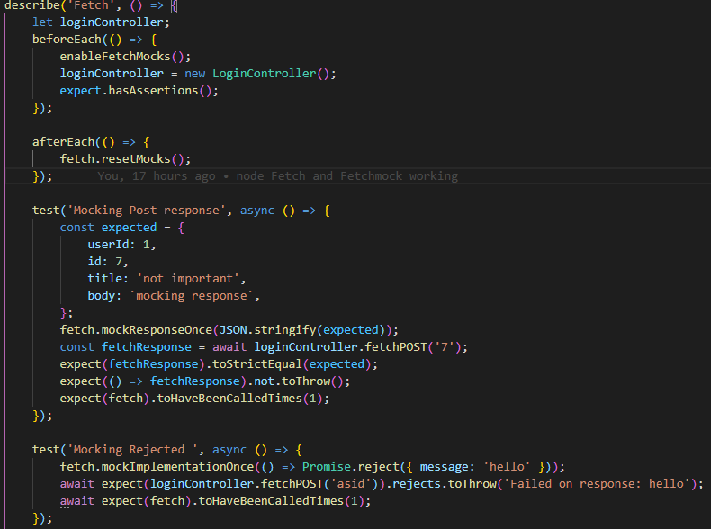
Mocking fetch
In this case, we need to clear the fetch after each test, as well as create a new LoginController.
We will hard code the response: we are setting that fetch will retrieve that object.
So, when testFetch will fetch, it will actually fetch… the response set before. The fact that we are sending an id to testFetch doesn’t really matter (but we need it as a parameter)
On the expect, we are making sure that we are comparing to an object that looks exactly as it.

Slide 36
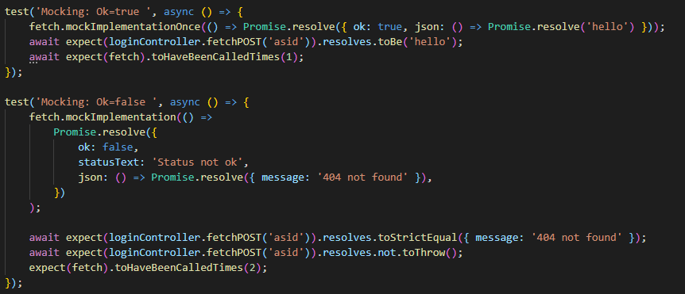
Mocking fetch
We can also mock a response with its status !ok.
In that case, those responses are still resolved. These are the cases of 4XX and 5XX.
We can check that our function doesn’t throw an error on !response.ok

Slide 37
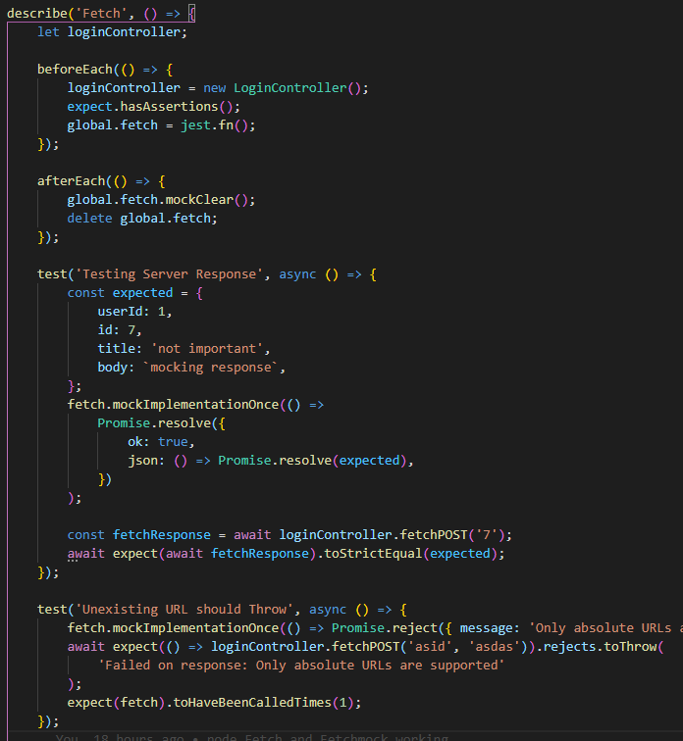
Testing fetch by using jest.fn()
We can also mock functions.
In this case, we will like to replace the fetch function, for one of our own.
Since in each test we are testing for something different, we will set the result of that fetch as the value that we pretend to get from the server.
For that, we will mock the resolved value once with mockResolvedValueOnce
This is a more Vanilla approach for solving fetch.

Slide 38
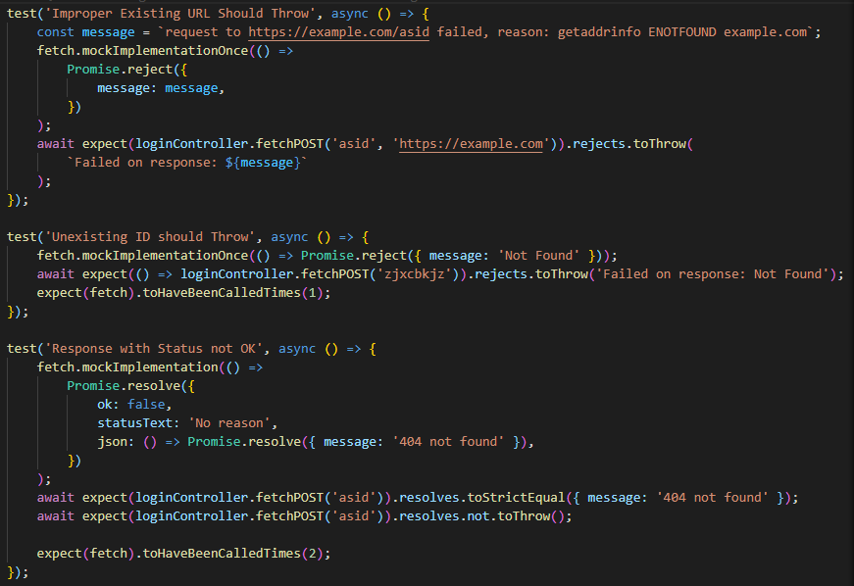
Testing fetch by using jest.fn()

Slide 39
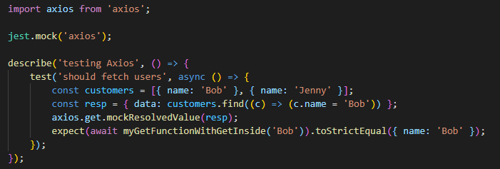
Mocking a Module
Mocking while testing is one of the core features you will need to implement.
Jest is great for mocking not only your functions but also your modules.
For example, let’s say you want to test a function that fetches users. It uses axios, but we don’t want to hit a real endpoint because that’s not what we want to test.

Slide 40
Testing console methods
Since we are running on Node and not a real browser, we can’t get use of some methods that they are in the global scope, like the console ones. (console.log, console.error, console.warn, etc)
To workaround this, we can create a mock of those methods or use spies.
Mocks: Allows us to abstract from an implementation, and assign new behaviour / return values.
Spies: Allows us to inspect an implementation, the real function / module will run. We can still mock up its values.

Slide 41
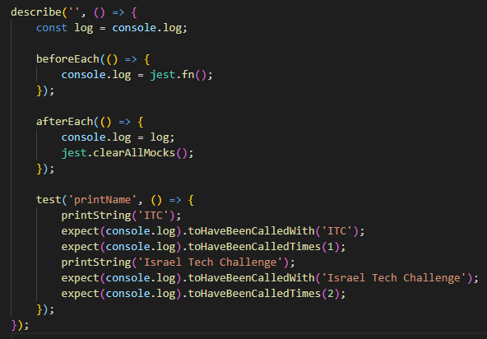
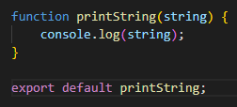
Testing console methods
Using a Mock
In this case, we are mocking the real console.log function.
Before doing that we are storing the real one in the const log, and restoring it afterEach test.

Slide 42
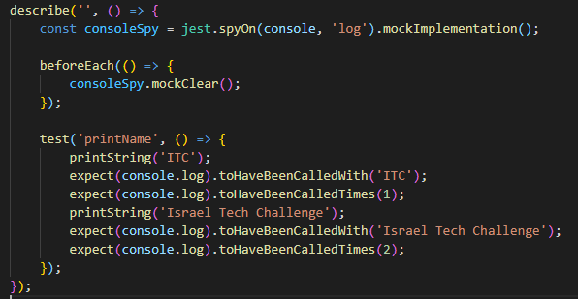
Testing console methods
Using a Spy
Mocks replaces the whole method for one of yours, and allows you to mock the result.
Spies, are similiar, but without modyfing the original method. We can also mock the return values, but we can’t mock the whole method. They are very similar for this case, but spyOn delivers a cleaner syntax.

